Slide 1

Improving Marketing Approach
AI & Analytics CoE, DM&A

Slide 2
Identifying the customer segments for distributing the offers and type of offers?
Hypothesis:
Customer having recency between 10-12 months have less probability to convert.
Users who have used BOGO offers in past are having higher probability of conversion through BOGO.
Is region one of the significant feature for conversion of customers.
Does referral customers have more chances of conversion.
Customers who have used discount in the past are having lesser chances to convert.
BOGO is better than discount offers for higher conversion.

Slide 3
Methodology
Descriptive analytics is performed to understand the distribution of data and identify the hidden patterns.
Uplift modeling technique is used with XGBoost to measure the incremental impact of a treatment (such as a direct marketing action) on an individual's behavior(recency, referral, historical records etc).
For model evaluation, we used uplift score and QINI curve.

Slide 4
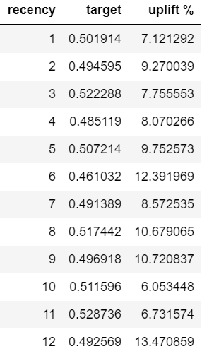
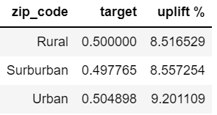
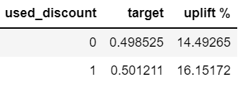
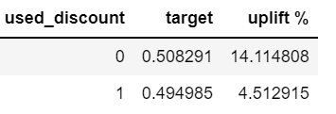
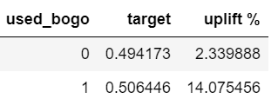
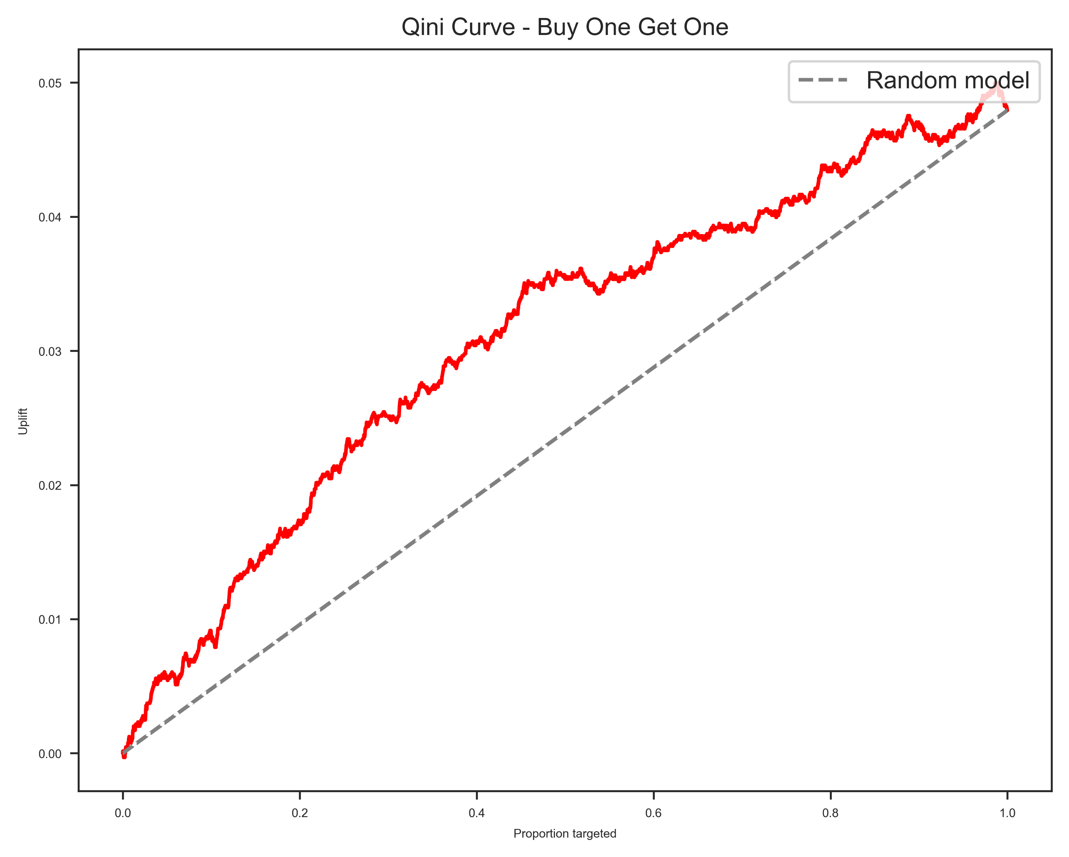
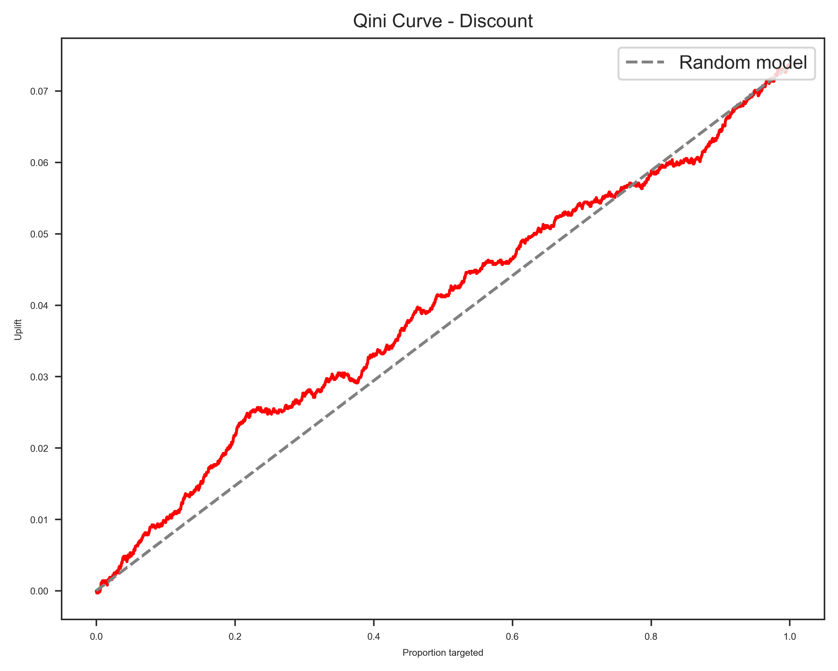
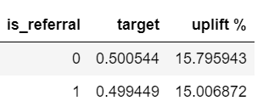
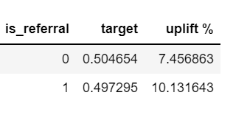
Results
1. Customer having recency between 10-12 months have less probability to convert.
3. Is zip code one of the significant feature for conversion of customers.
5. Customers who have used discount in the past are having lesser chances to convert.
Customer with recency of 12 months have higher uplift as compared to others
No, Zip Code is not a significant feature
For users who already uses the Discount offer before, the uplift effect of BOGO is minimal => Cancel-out effect between 2 approaches
Discount
BOGO
2. Users who have used BOGO offers in past are having higher probability of conversion through BOGO.
4. Does referral customers have more chances of conversion.
6. BOGO is better than discount offers for higher conversion.
For users who are familiar with BOGO before, the uplift effect is stronger(14%).
No, there is no uplift in case of discount and slight difference in uplift in BOGO
Qini curve is covering more area as compared to Discount offer. Therefore, BOGO is performing better than Discount offer
Discount
*Uplift Score = P(CN)/P(C) + P(TR)/P(T) - P(TN)/P(T) - P(CR)/P(C)
**QINI = (TR/T) - (CR/C)

Slide 5
Recommendation's
As a marketing strategy, we recommend to follow below data driven approaches
We should target customers with more BOGO offers who have used BOGO in the past.
Targeting customers who has more than 11 months of recency.
Discount and referral customers does not have any significant uplift of marketing offers. So, the prime focus should be on new customers or BOGO customers.
Higher budget should be allocated to BOGO compared to discount offers.

